Slide 1
SOLID Design Principles

Slide 2
Agenda
Introduction
Design Principles
Why SOLID

Slide 3
Introduction
SOLID Principles is a coding standard that all developers should have a clear concept for developing software in a proper way to avoid a bad design.
SOLID Principles are the design principles that enable us manage most of the software design problems.
The term SOLID is an acronym for five design principles intended to make software designs more understandable, flexible and maintainable.

Slide 4
Design Principles
S : Single Responsibility Principle
O : Open Closed Principle
L : Liskov Substitution Principle
I : Interface Segregation Principle
D : Dependency Inversion Principle

Slide 5
SINGLE Responsibility Principle

Slide 6
Single Responsibility Principle
A class should have only one reason to change.
Every module or class should have responsibility over a single part of the functionality provided by the software, and that responsibility should be entirely encapsulated by the class.

Slide 7
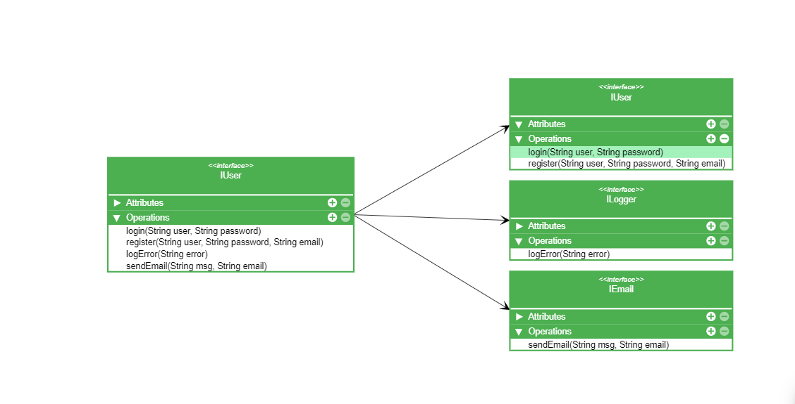
Design not following SRP
Design following SRP

Slide 8
Examples
Famous log4j API for logging purpose.
Spring modules.
JPA (Java Persistence API) - manage data persisted in a relational database by using the object-relational mapping concept.

Slide 9
Open Closed Principle

Slide 10
Open Closed Principle
Software entities such as classes, modules, functions etc. should be open for extension, but closed for modification.
The design and writing of the code should be done in a way that new functionality should be added with minimum changes in existing code.
Simplest way to apply this principle is to implement new functionality on new derived classes.

Slide 11
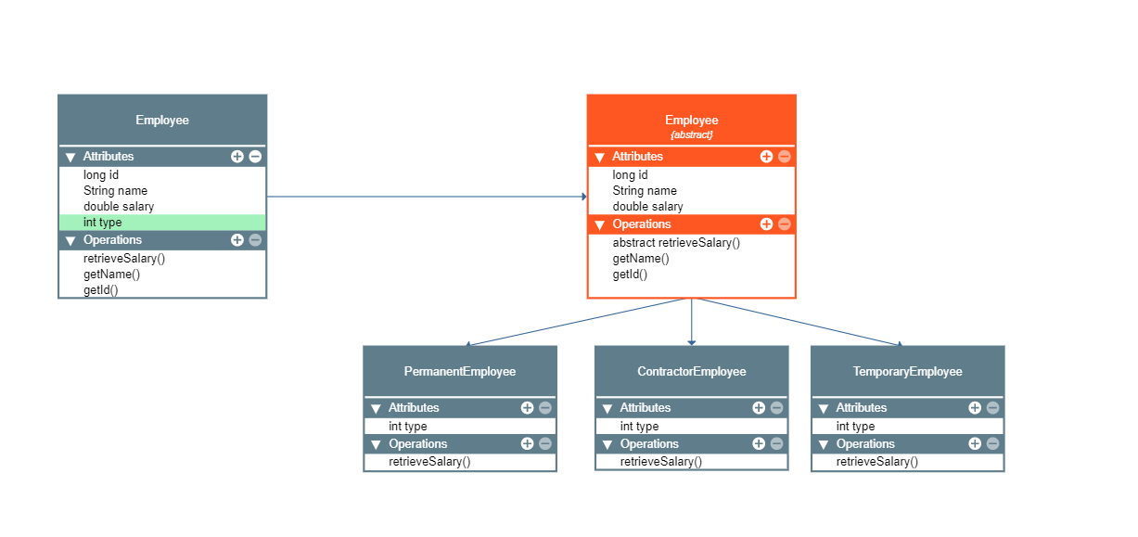
Design following Open
Closed Principle
Design not following
Open Closed Principle

Slide 12
Examples
All abstract classes like AbstractList etc.
Spring Framework has class DispatcherServlet which acts as front controller. To use this class, we don’t need to modify this class, all we need is to pass initialization parameters and we can extend the functionality the way we want.

Slide 13
Liskov Substitution Principle

Slide 14
Liskov Substitution Principle
Objects in a program should be replaceable with instances of their subtypes without altering the correctness of that program.
If a program module is using a Base class, then the reference to the base class can be replaced with a derived class without affecting the functionality of that program module.
We can also state that derived types must be substitutable for their base types.
Implemented class should not throw any new exceptions.

Slide 15
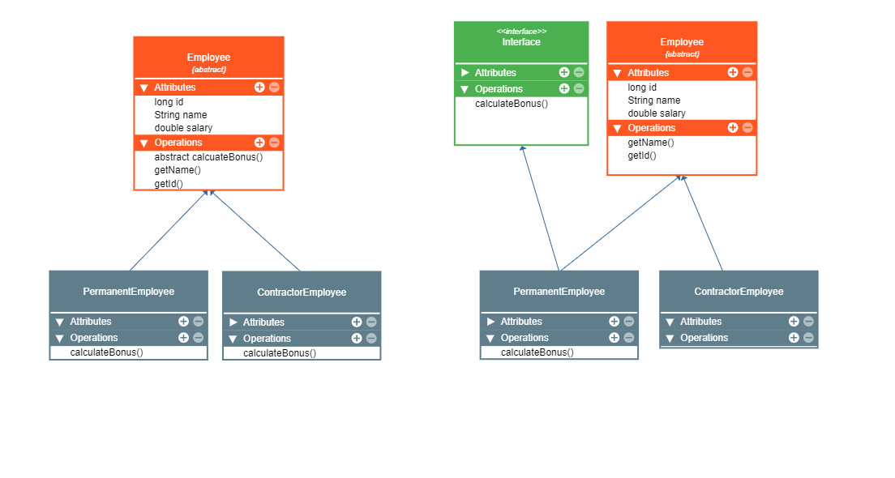
Design not following Liskov
Substitution Principle
Design following Liskov
Substitution Principle

Slide 16
Interface Segregation Principle

Slide 17
Interface Segregation Principle
Many client-specific interfaces are better than one general purpose interface.
We shouldn’t enforce clients to implement interfaces that they don’t use. Instead of creating one big interface, we can break it down to smaller interfaces.

Slide 18
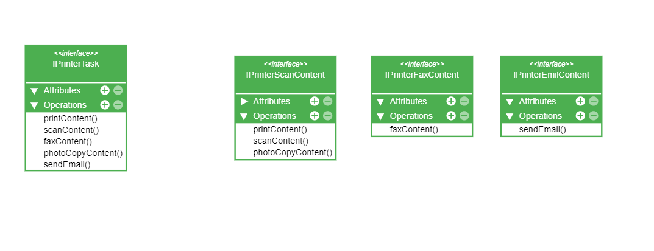
Design following Interface Segregation Principle
Design not following Interface Segregation Principle

Slide 19
Examples
Java AWT Event handlers for handling GUI events fired from keyboard and mouse. We only need to write handlers for events. Some of the listeners are : FocusListener, KeyListener, MouseListener, WindowFocusListener etc.

Slide 20
Dependency Inversion Principle

Slide 21
Dependency Inversion Principle
One should “depend upon abstractions”, [not] concretion.
Abstractions should not depend on the details whereas the details should depend on abstraction.
High level modules should not be depending upon low level modules.

Slide 22
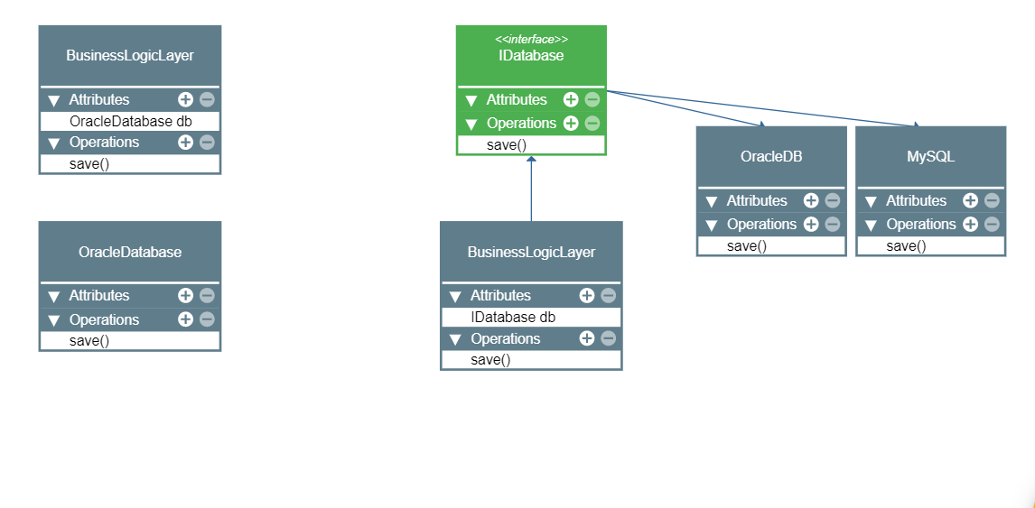
Design not following Dependency Inversion Principle
Design following Dependency Inversion Principle

Slide 23
Examples
Adapter Design pattern.
Classical example is Bean Configuration in Spring framework.

Slide 24
Why SOLID?
If we don’t follow SOLID principles we :
End up with tight or strong coupling of code with many other modules/applications.
Tight coupling causes time to implement any new requirement, features or any bug fixes and some times it creates unknown issues.
End up with a code which is not testable.
End up with duplication of code.
End up creating new bugs by fixing another bugs.
End up with many unknown issues in the application development lifecycle.

Slide 25
Why SOLID?
If we follow SOLID principles, It helps us to:
Achieve reduction in complexity of code.
Increase readability, extensibility and maintenance.
Reduce error and implement reusability.
Achieve better testability.
Loose coupling.

